Slide 1
COEN 242 - Big Data Project (Summer 2015)
K-means clustering on US Airlines data
Group 2
Ankita Mukherjee - W1159698
Madhumitha Mani - W1157297
Manroop Singh - W1166831
Sumana Hariharan - W1167638
Swati Prasad - W1167721

Slide 2
Agenda
Problem Overview
Dataset Description
Data preprocessing
Remove missing values
Remove duplicates
Remove noisy data
Remove outliers
Finding optimum K - Elbow technique
Data conversion
Execution of kmeans in Weka,Mahout and R
Data visualization
Outlier analysis
PAM using R
Performance comparison between Weka and Mahout
Challenges faced and lessons learnt
Conclusion

Slide 3
Problem Overview
flight delays is one of the challenging problem for the airline companies that lead to financial losses and in turn leads to negative impact on their business reputation
US airlines dataset has up-to-date information about all the flights, hence a good candidate to apply mining algorithms and find patterns in the data
the current challenge is to improve the quality of airline on-time performance
Goal:
to find valuable and interesting relationship from the dataset by using data mining techniques on big data like cluster analysis

Slide 4
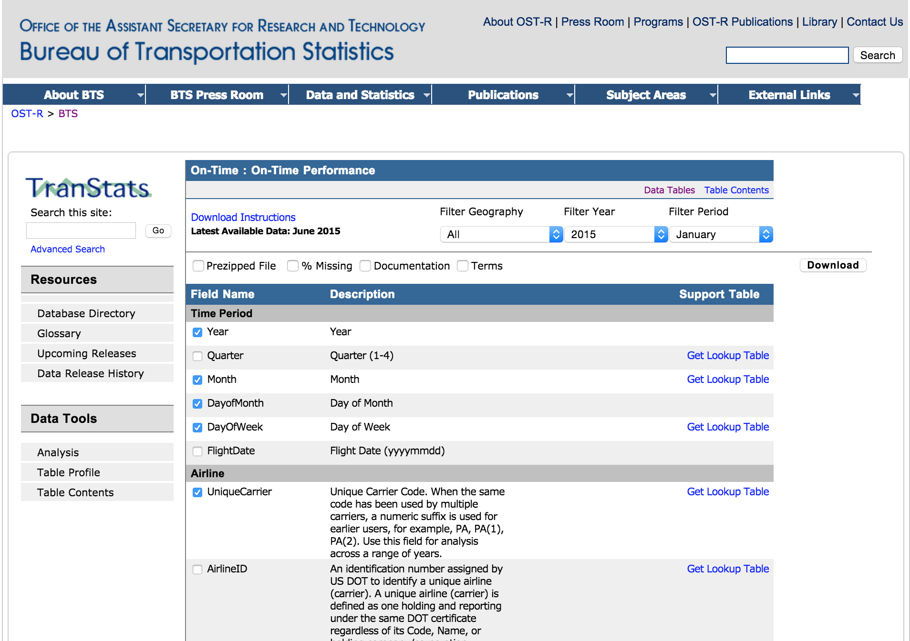
Dataset Description
dataset is US airlines data coming from Bureau of Transportation Statistics
contains more than 12GB of data about airlines and airport in US from 1998-present
the dataset includes more than 100 attributes which include information like Departure Time, Arrival Delay, Carrier information etc.
http://www.transtats.bts.gov/DL_SelectFields.asp?Table_ID=236&DB_Short_Name=On-Time

Slide 5
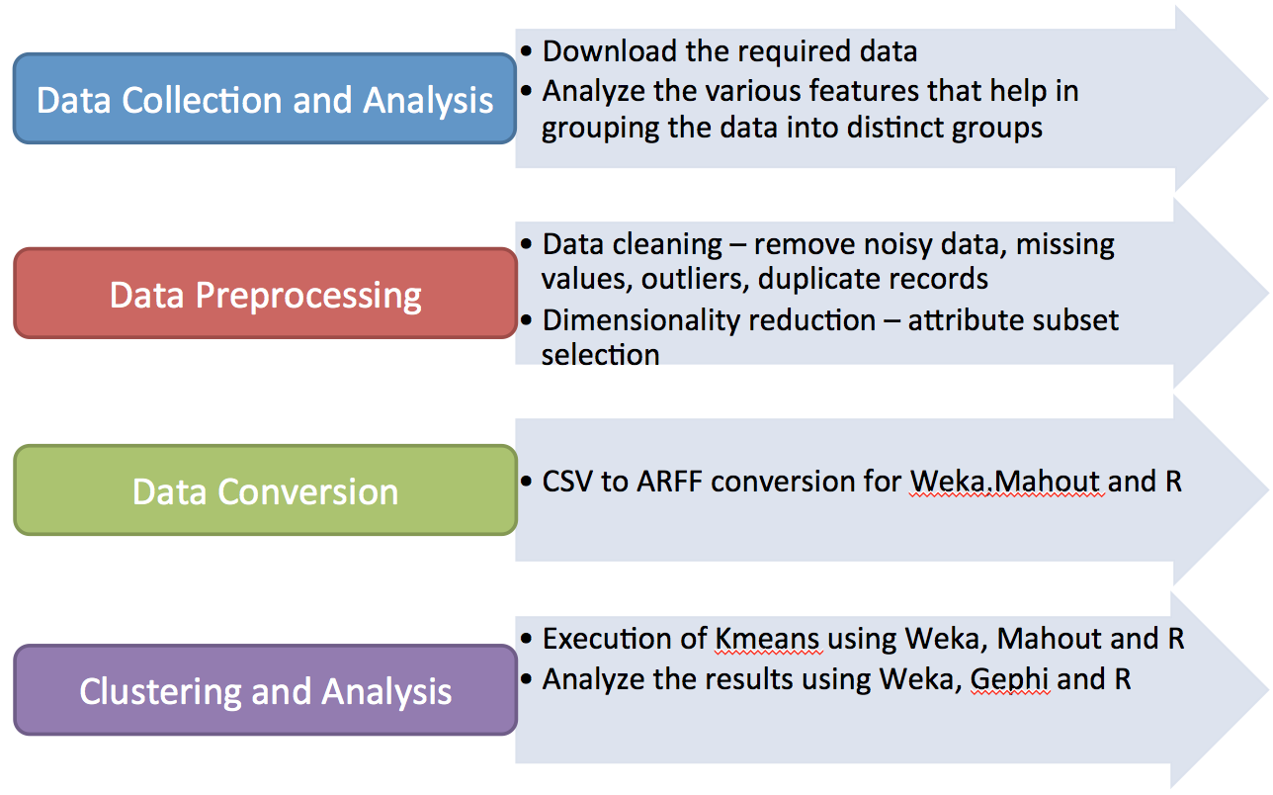
Project phases

Slide 6
Data Collection and Analysis
dataset had >100 features but the % of missing values on some features was quite high - hence ignored ; 17 attributes were selected
the delay fields had negative values, indicating that there was no delay
there was no class label already associated with each tuple, hence the dataset was a candidate for clustering
we chose Kmeans clustering because
widely used as a preprocessing step for other machine learning algorithms
has implementation in both Weka and Mahout, hence performance of the two can be studied
outlier analysis will be effective

Slide 7
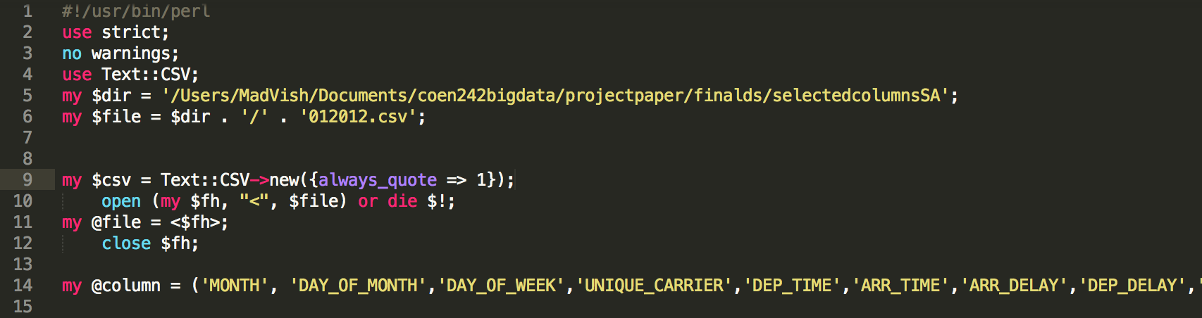
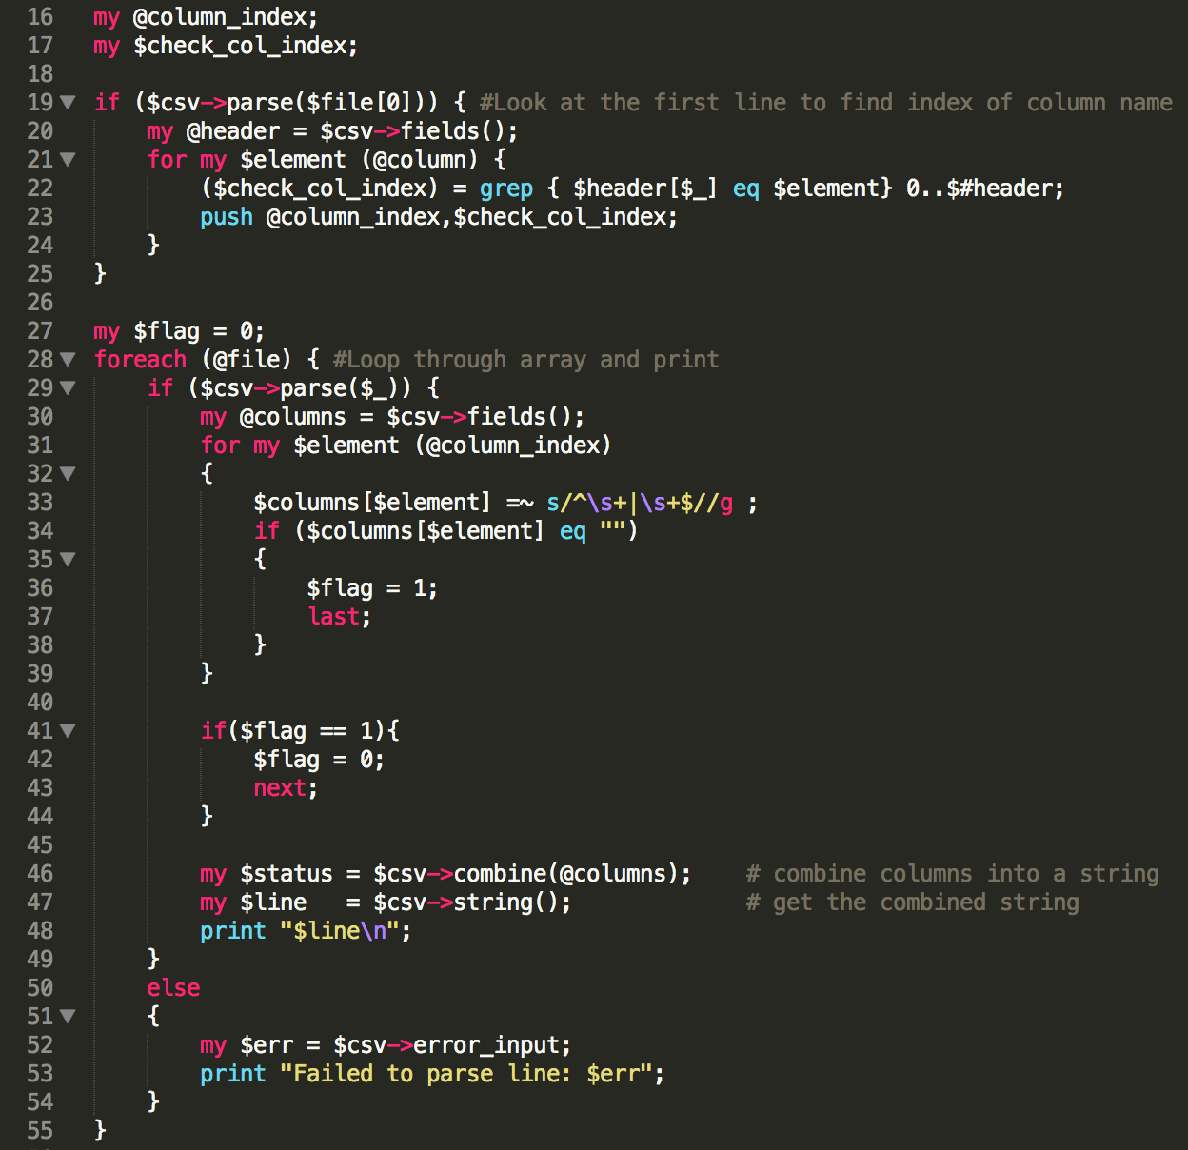
Data Preprocessing - Remove missing values
Perl script
attributes whose values are mandatory are checked for missing values
eg : Arrival delay, Departure Time,Unique Carrier, Origin, Destination etc
Method: Ignore the tuple if any missing values were found
Notes:
Used Text::CSV to parse the CSV files

Slide 8
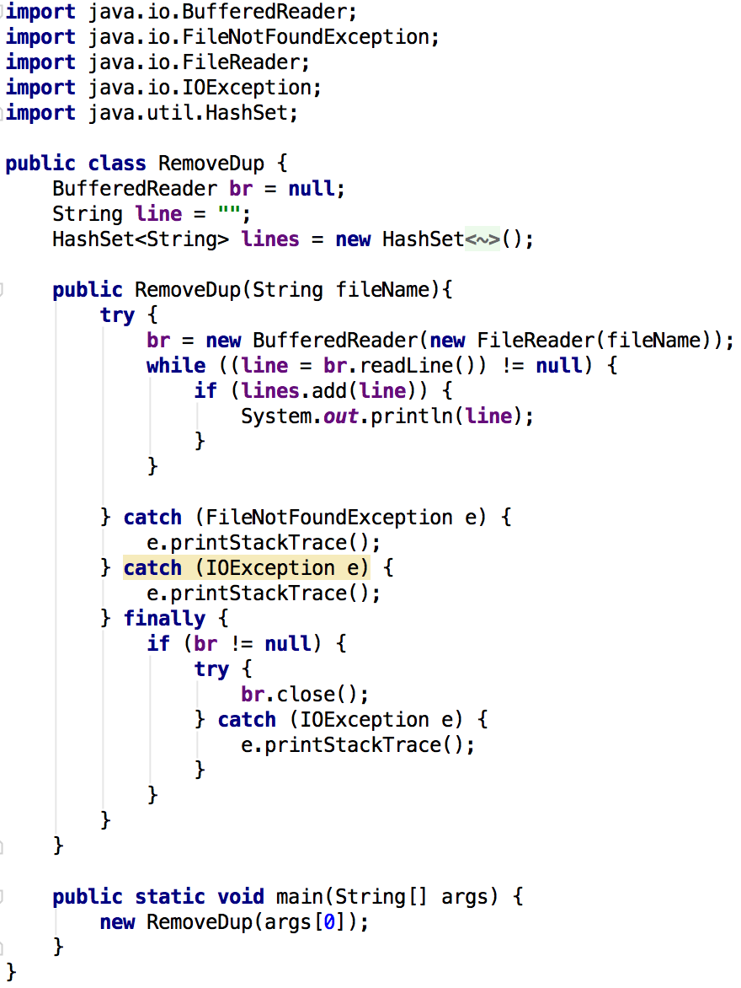
Data Preprocessing - Remove duplicates
The duplicate tuples in the data were removed using code written in java
Command: java -jar preprocess.jar missingvaluesSA/2012.csv > noduplicates/2012.csv

Slide 9
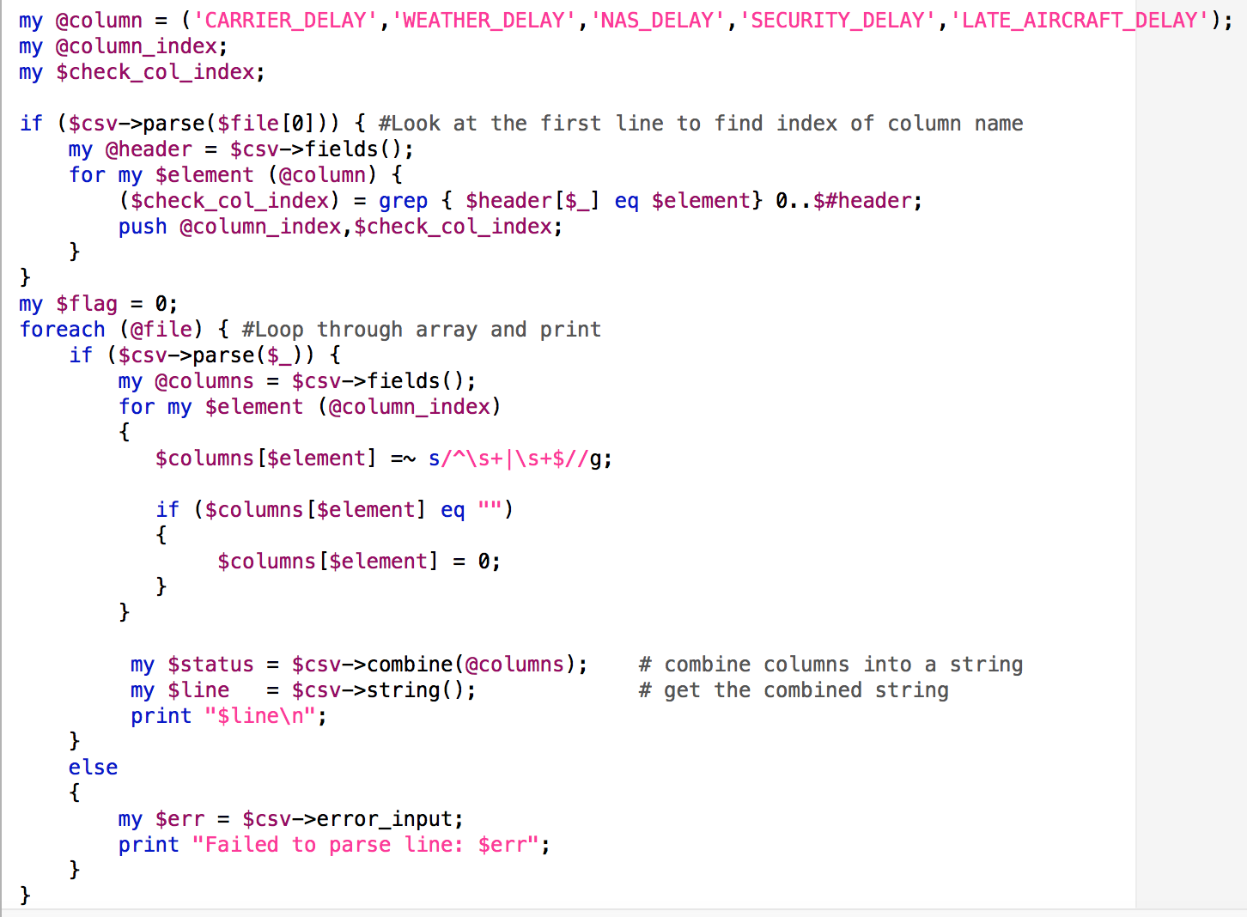
Data Preprocessing - Replace default value as 0
Different types of delay.
Default values is empty value.
Script to replace that with 0.

Slide 10
Data Preprocessing - Remove noisy data
noisy data is random error or variance in a measured value
noise may distort the normal objects and blur the distinction between normal objects and outliers
may reduce the effectiveness of outlier detection
Eg: arrival delay of 1823mins/30hours or early arrival of 411mins/6hours seems like noise like noisy data
Criteria: Remove arrival delay > 500mins or early arrival > 30 mins

Slide 11
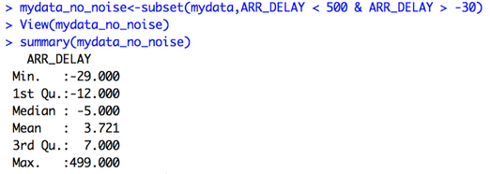
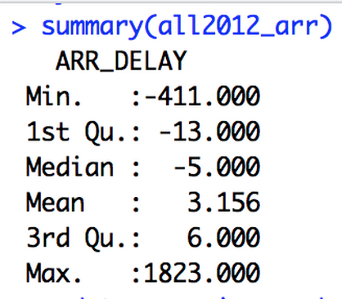
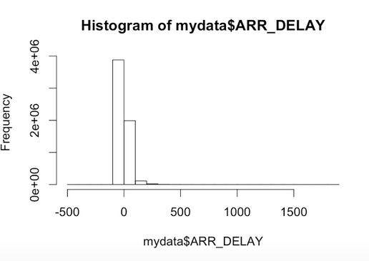
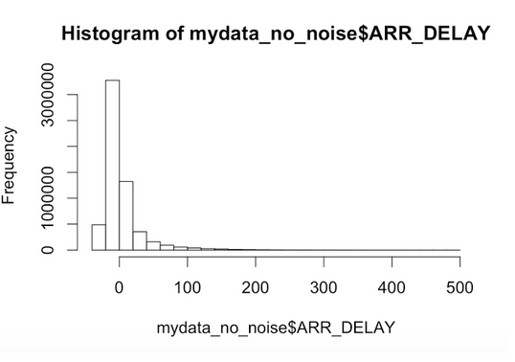
Data Preprocessing - Remove noisy data using R
Noisy data
Noise removed

Slide 12
Data Preprocessing - Remove outliers
data objects that deviate significantly from the normal objects as if they were generated by a different mechanism
Method: Using Interquartile range (IQR)
Find the IQR : Q3 - Q1
Calculate (Q1 - 1.5 ) * IQR and (Q3 + 1.5) * IQR
Any data objects that fall outside the above range are considered noise
Eg: In airlines dataset -> IQR = 19
Range: -256.5 to 161.5
http://www.unc.edu/~rls/s151-09/class4.pdf

Slide 13
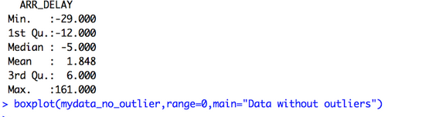
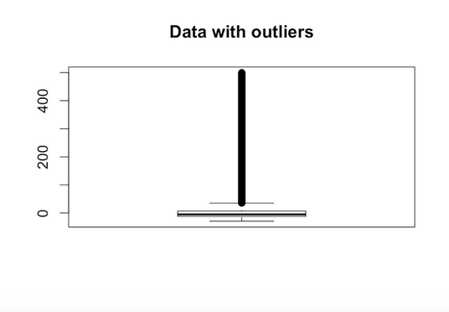
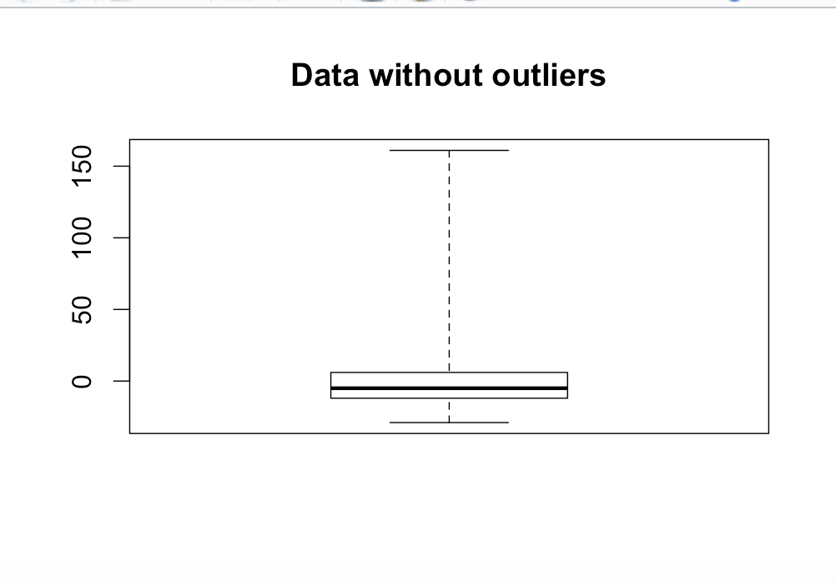
Data Preprocessing - Remove outliers using R
No Outlier - boxplot
Outlier - boxplot

Slide 14
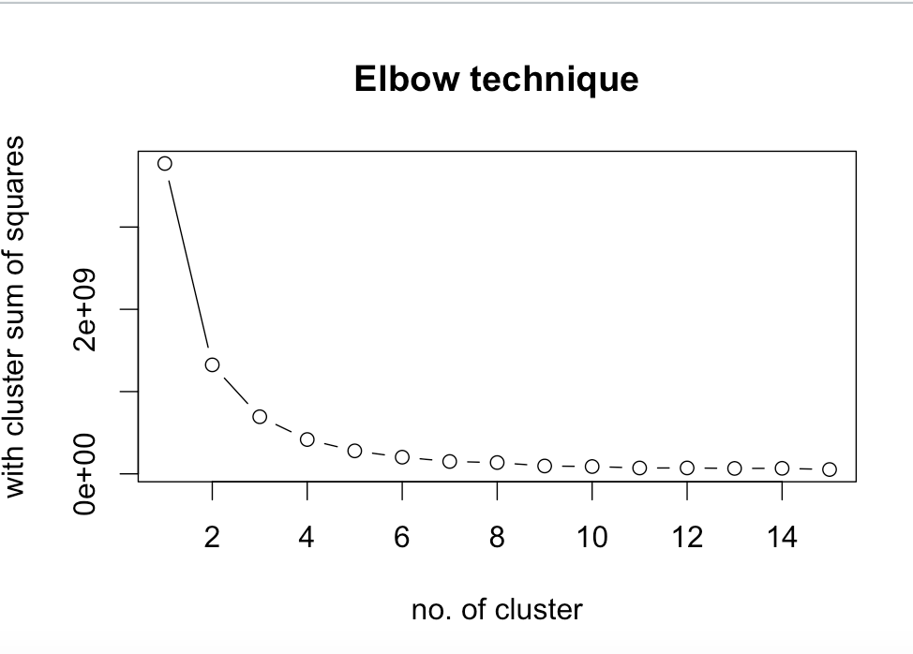
Finding the optimum K - Elbow Technique
Choose k so that adding another cluster doesn't give much better modeling of the data
Plotting the percentage of variance explained by the clusters against the number of clusters, the first clusters will add much information (explain a lot of variance), but at some point the marginal gain will drop, giving an angle in the graph
k is chosen at this point, hence the "elbow criterion".
https://en.wikipedia.org/wiki/Determining_the_number_of_clusters_in_a_data_set
http://www.edureka.co/blog/clustering-on-bank-data-using-r/
http://web.stanford.edu/~hastie/Papers/gap.pdf

Slide 15
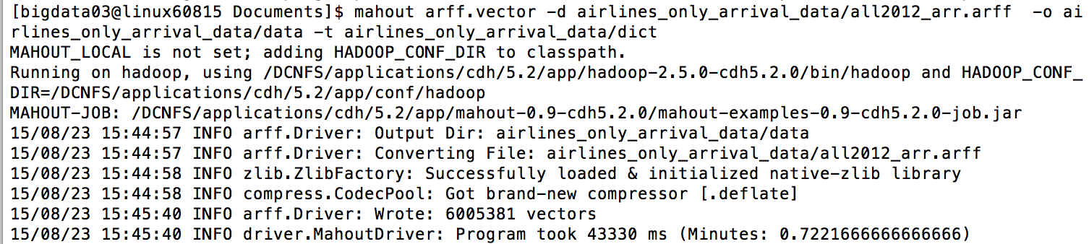
Data Conversion
CSV to ARFF Conversion for Weka and Mahout
Used Weka’s command line for this conversion
ARFF file is converted to vector file for Mahout using command line given below -
http://mahout-hadoop.blogspot.com/2013/10/using-mahout-to-cluster-iris-data.html

Slide 16
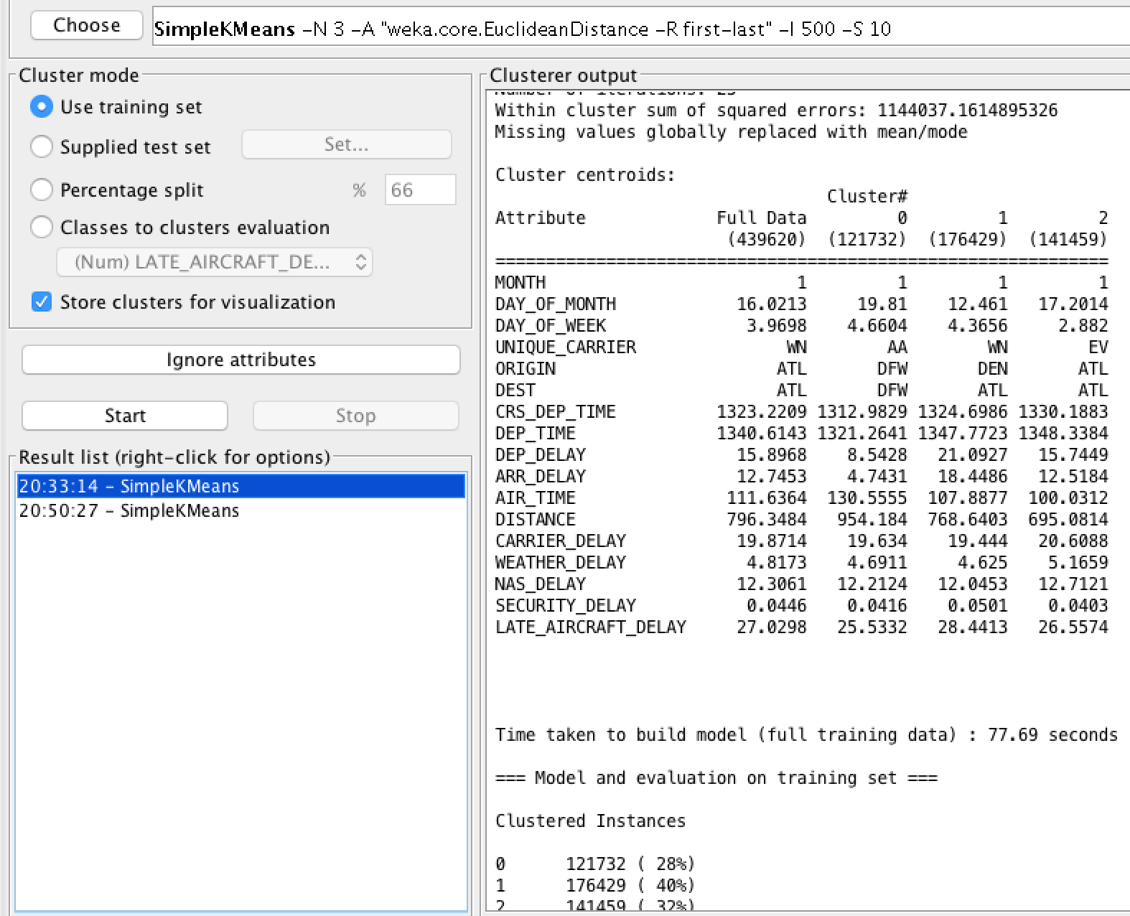
K-means with 17 attributes in Weka
Input : 17 Attributes
Year, Month,DayOfMonth,DayOfWeek,Departure Time ,Unique Carrier, Arr Delay , Dep Delay,Origin,Dest,Distance,AirTime,Carrier_Delay ,Weather_delay ,NAS_Delay,Security_Delay, Late_Aircraft_Delay
Criteria for execution
Number of clusters = 3
Max Iteration = 500
Initial seed = 10
Output: Large cluster sum of squared errors

Slide 17
Mahout - K-means execution steps
Convert the CSV to ARFF format
Generate vectors from the ARFF file using
mahout arff.vector -d all2012_dep_arr_sample.arff -o airlines_dep_arr_sample/data -t ~/Documents/airlines/dep_arr_noisy_sample
Initially used Canopy to find the initial centroids, but canopy is deprecated in Mahout, hence did not use it
Run K-means using the same criteria as in Weka
mahout kmeans -i airlines_dep_arr_sample/data -o airlines_dep_arr_sample/project-output -k 3 -c airlines_dep_arr_sample/output --maxIter 500 -dm org.apache.mahout.common.distance.EuclideanDistanceMeasure --clustering
Take clusterdump for visualization in Gephi
mahout clusterdump -i airlines_dep_arr_sample/project-output/clusters-8-final -o airlines_dep_arr_sample_output/airlines_2012_dep_arr_noisy_sample1.graphml -of GRAPH_ML -p airlines_dep_arr_sample/project-output/clusteredPoints

Slide 18

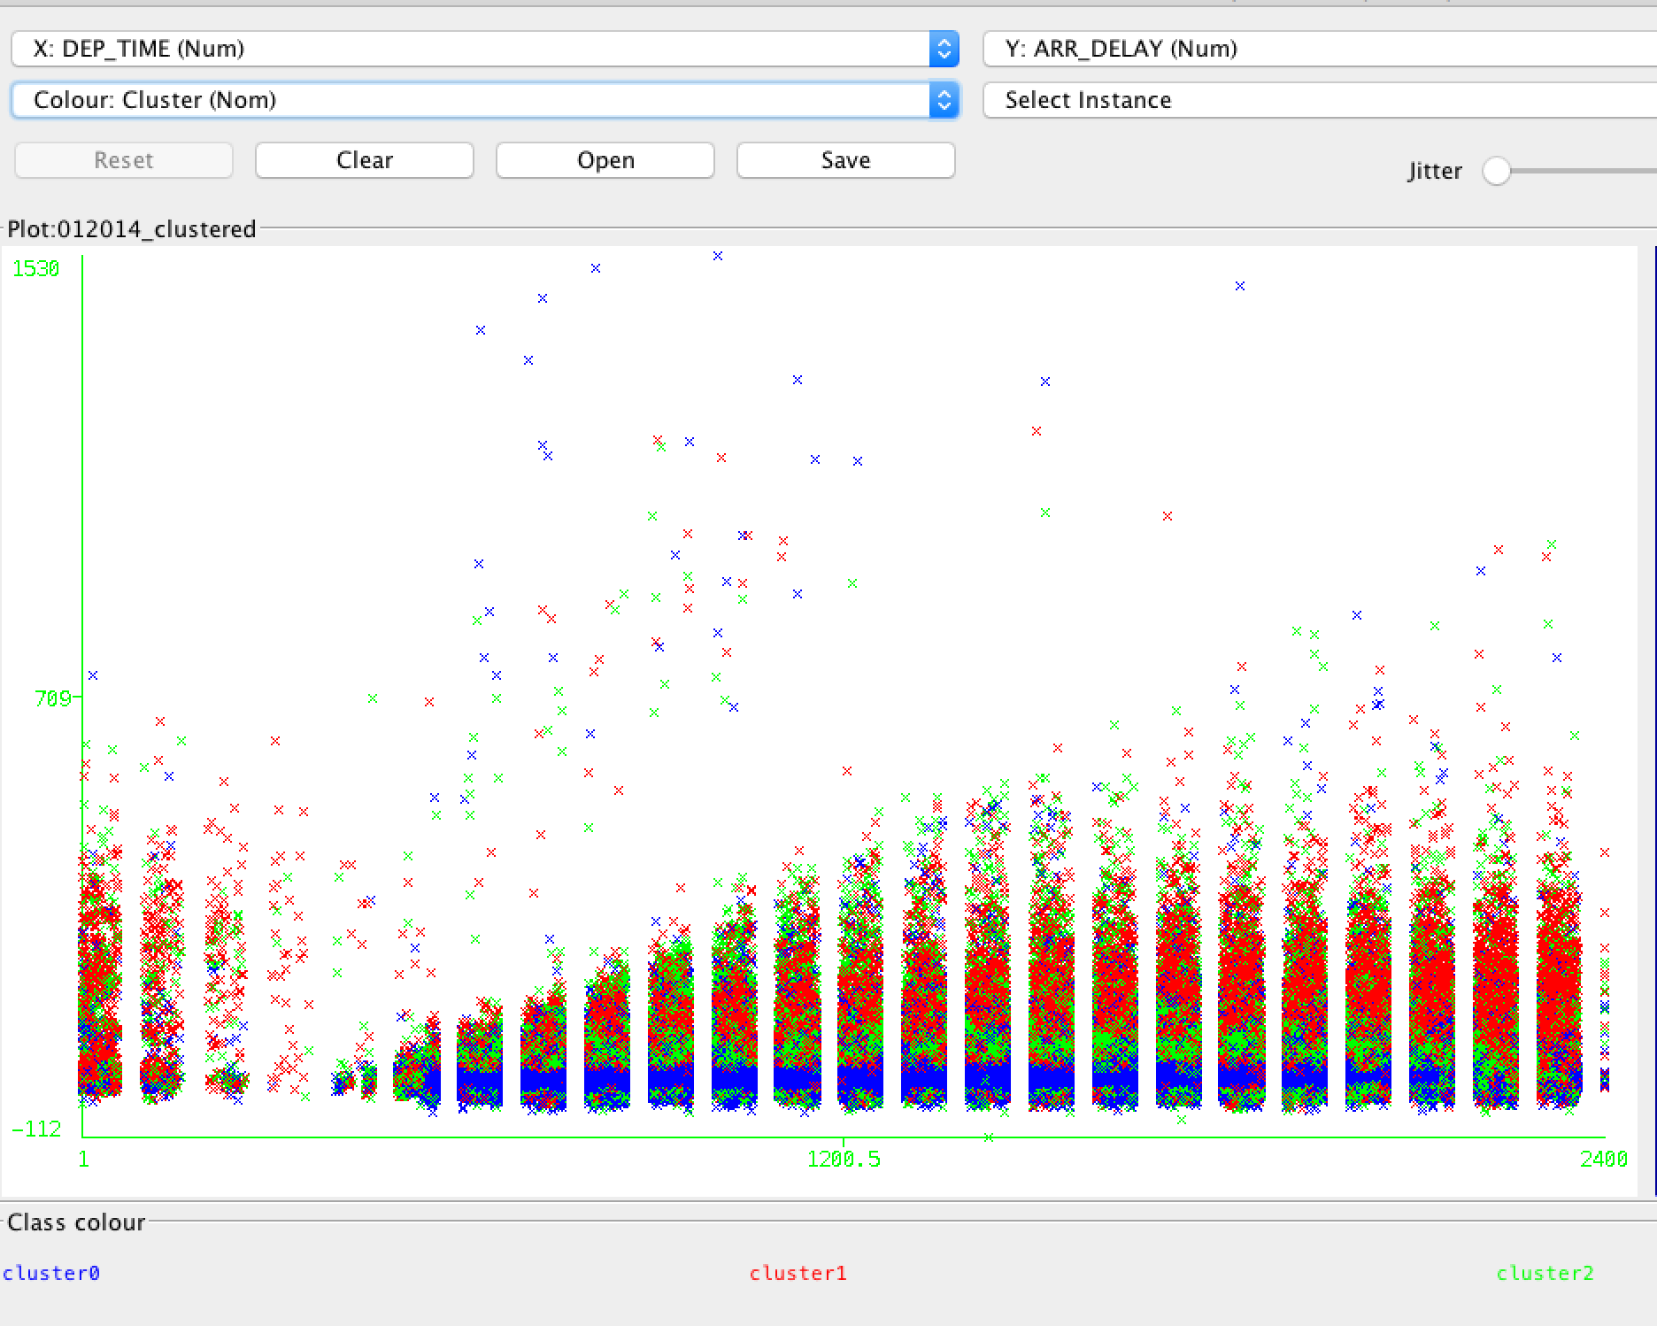
Problem - Visualization ?
Weka Visualization
Weka visualization

Slide 19
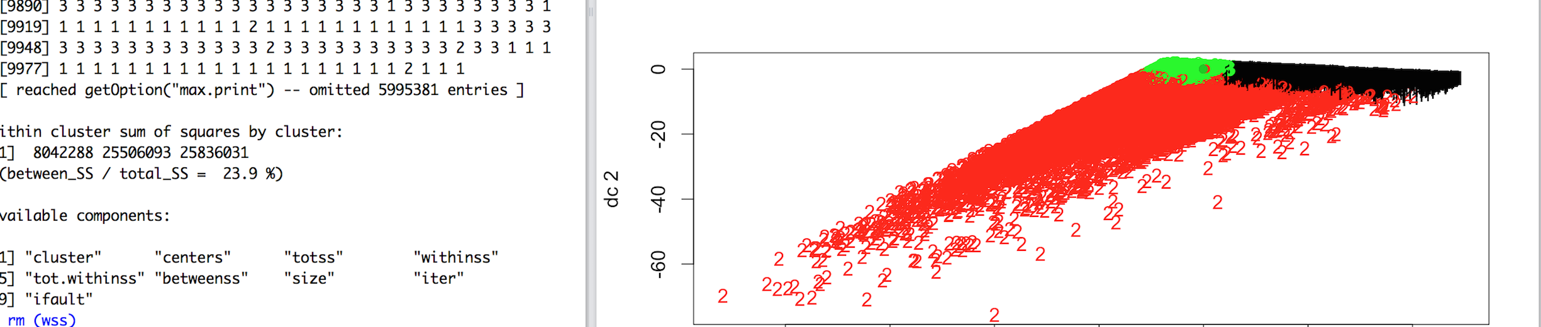
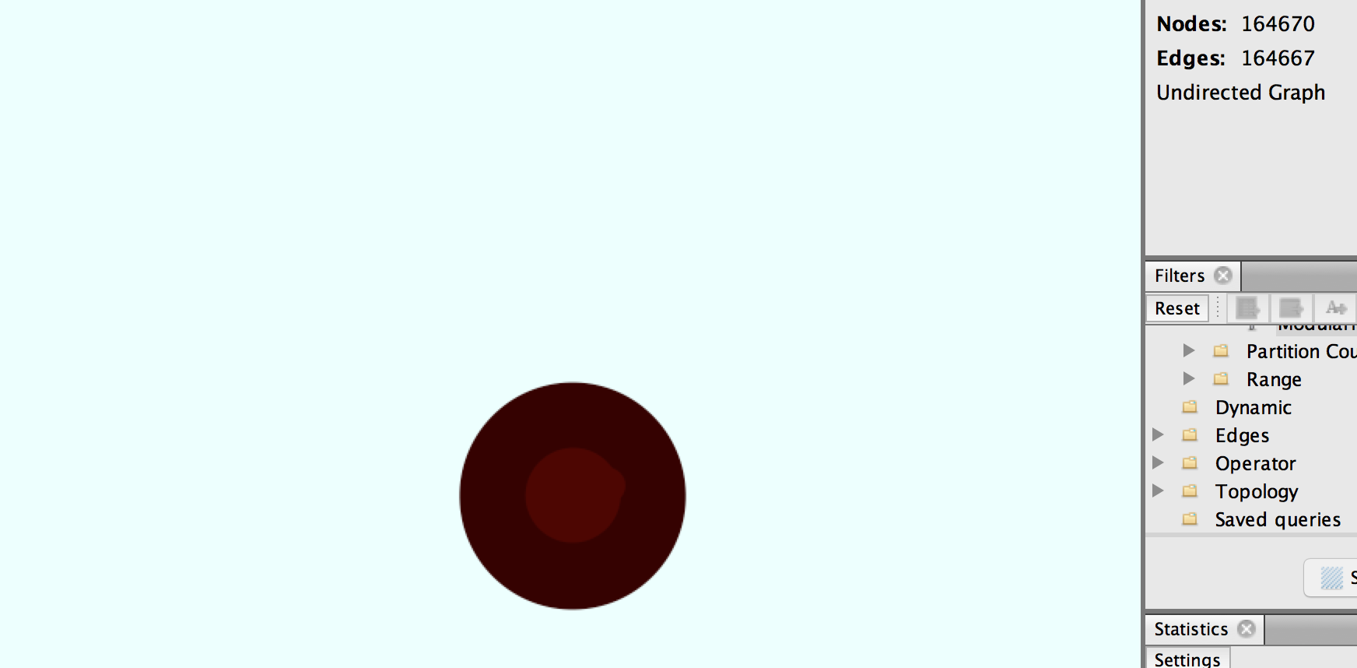
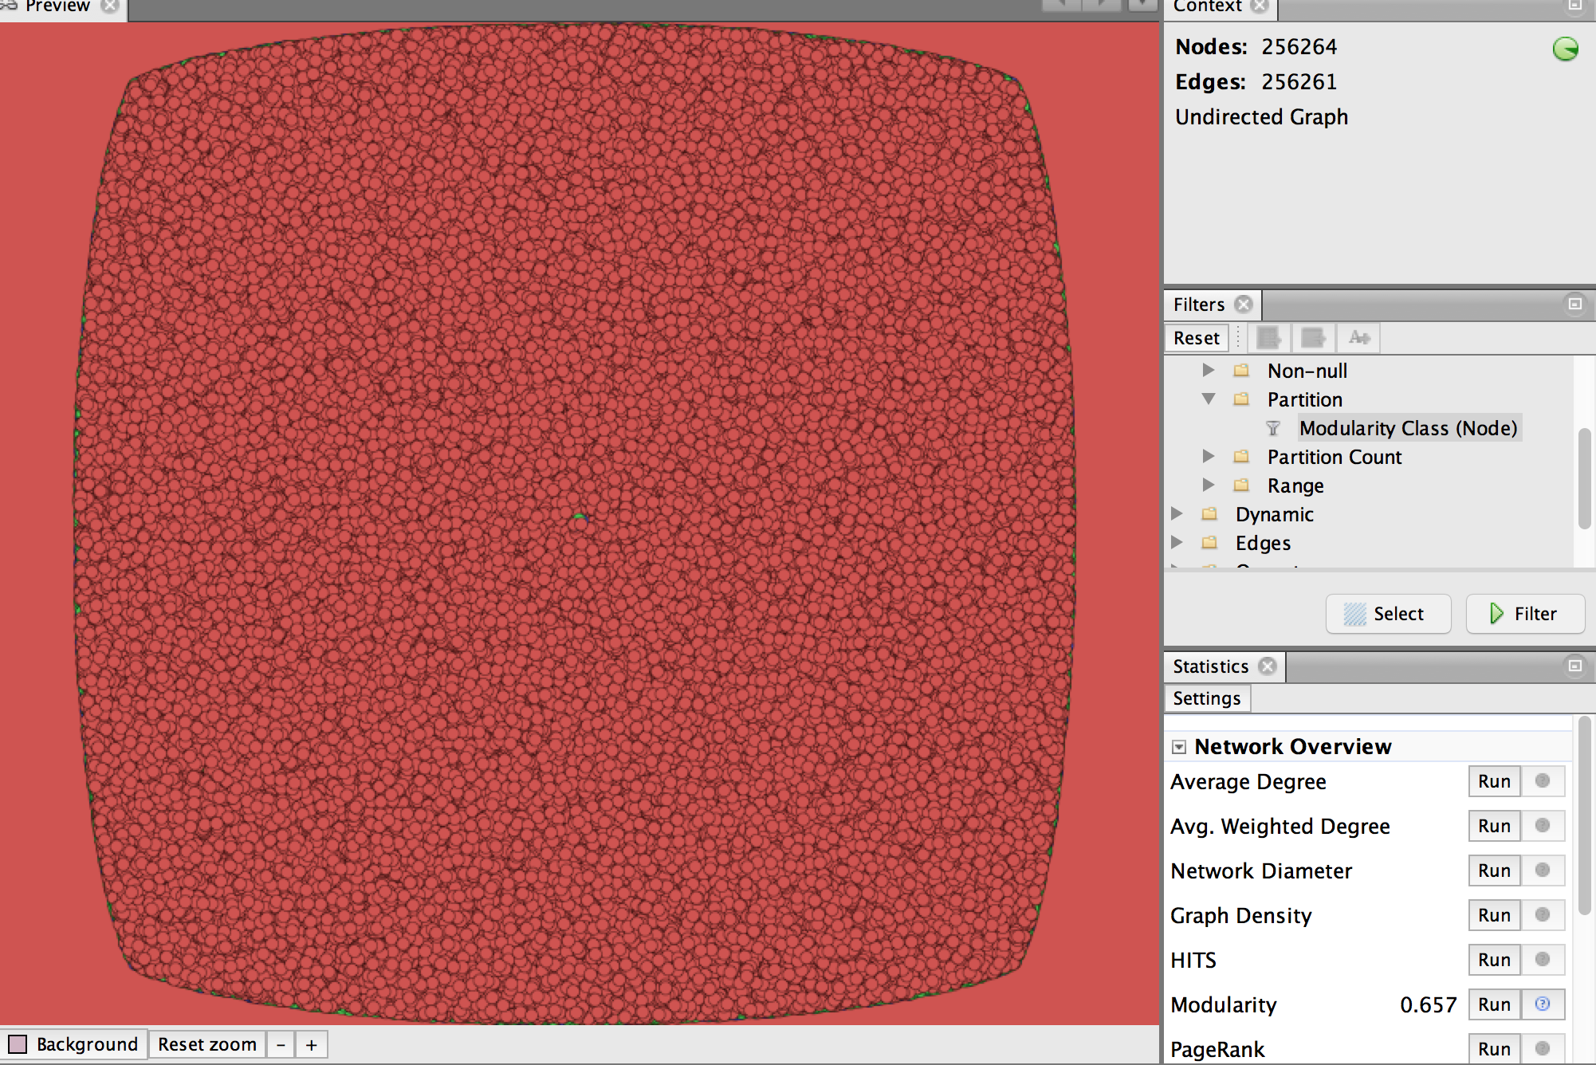
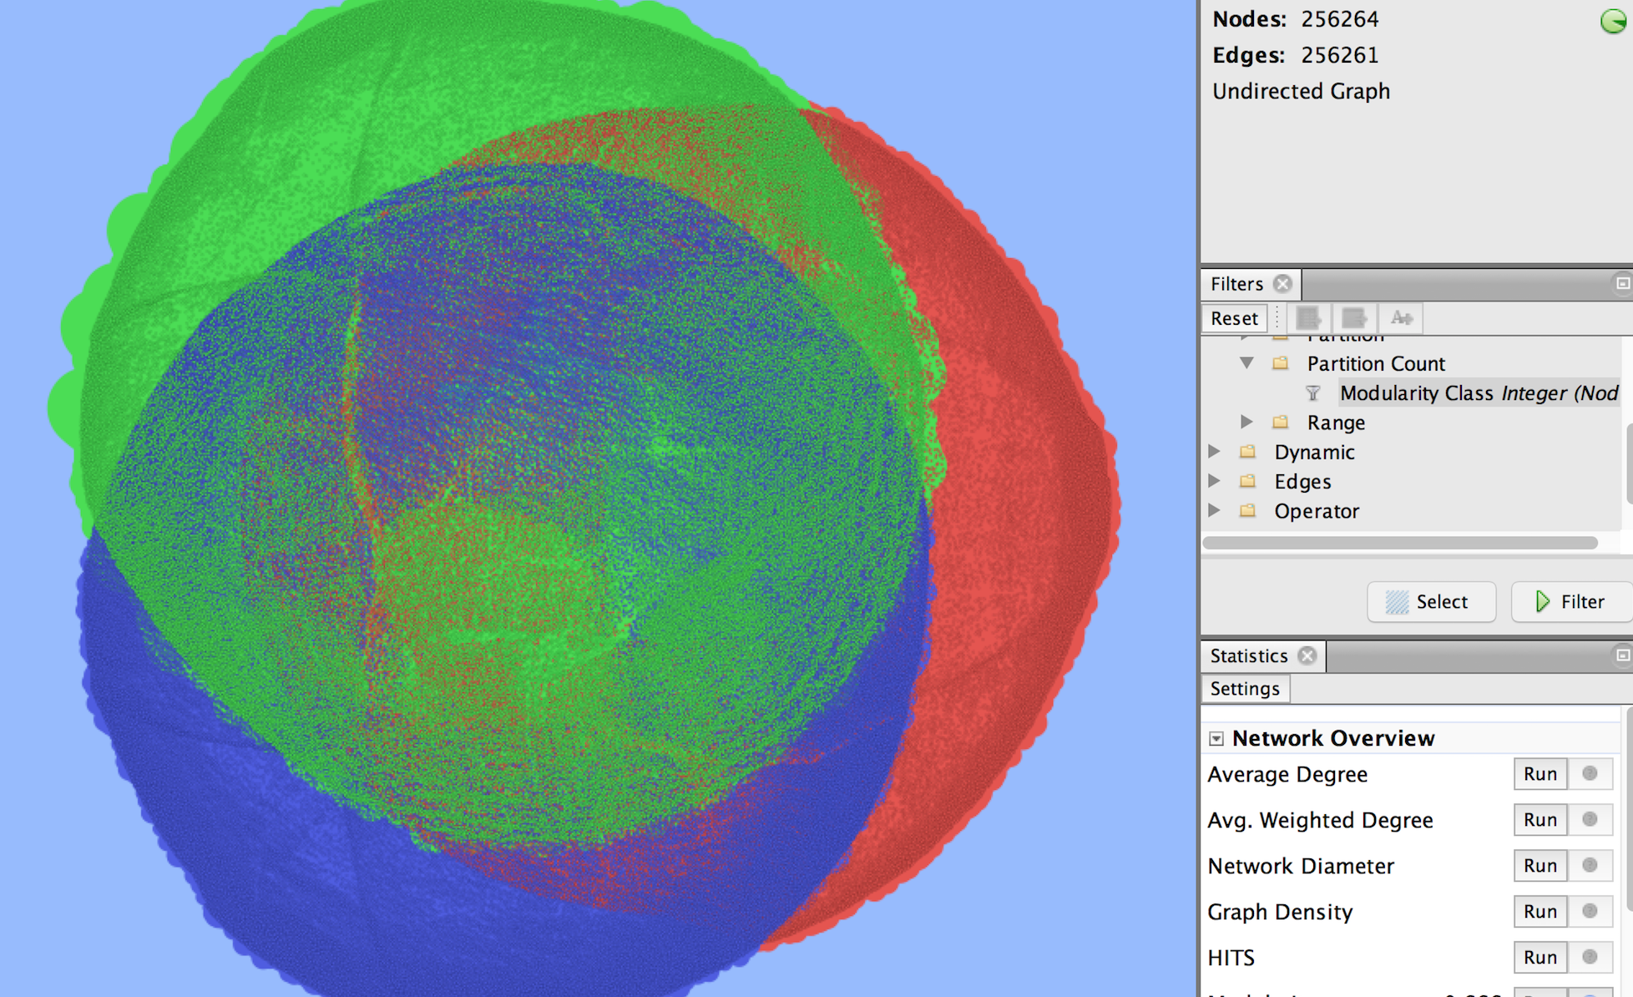
K-Means with 17 attributes in R and Mahout (300MB)
R Visualization Mahout data Visualization using Gephi
Due to the limitations of the Gephi tool that was used for Mahout data visualization, we could not visualize the clusters that was created on 17 attributes - the graphml file was >530MB

Slide 20
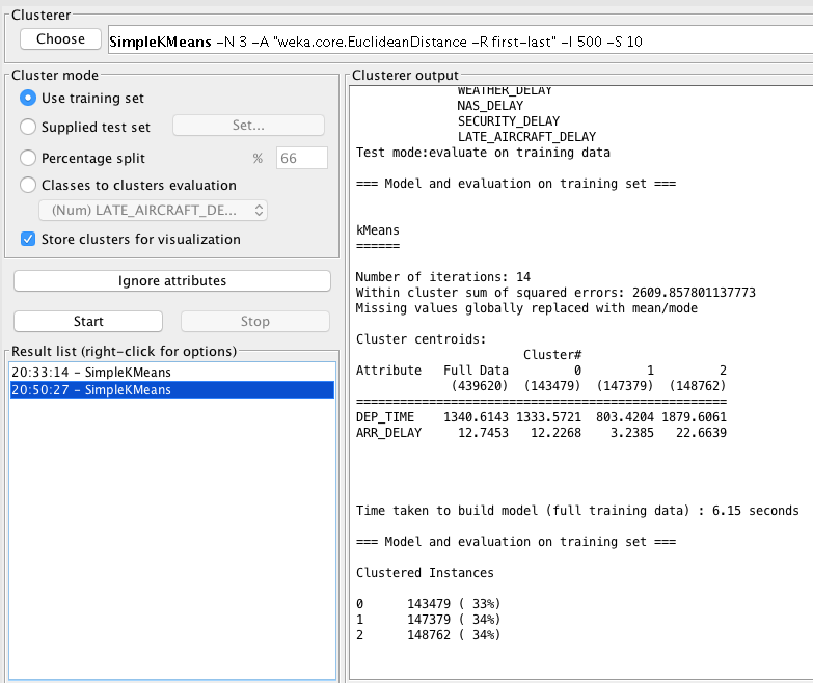
K-means on 2 attributes in Weka(~50 MB)
Input: Departure Time and Arrival Delay
Output: Reduced cluster sum of squared errors.
Pattern found - Arrival delay is more when the departure time is in the late evening (6PM) compared to the morning (8AM and 1PM)

Slide 21
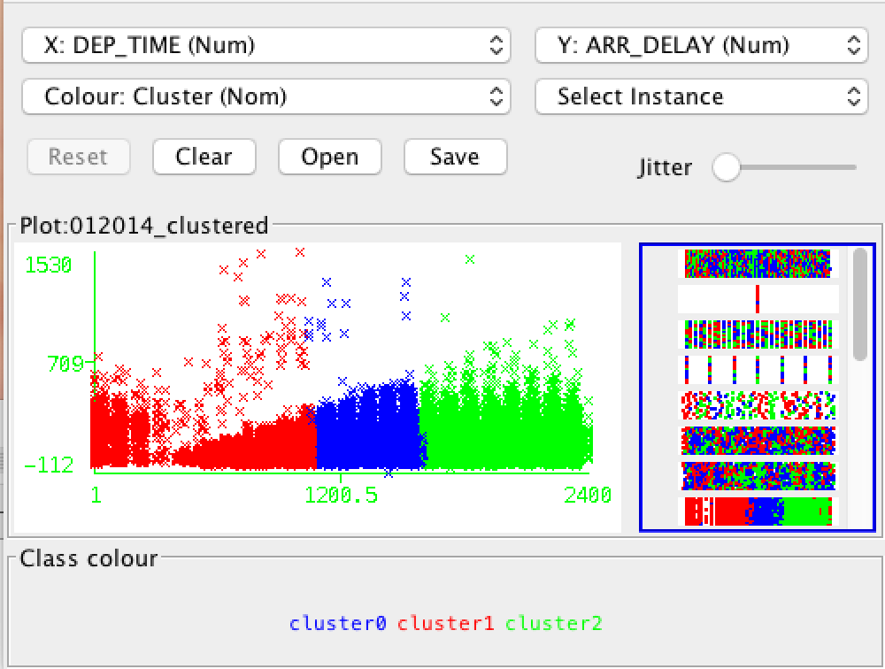
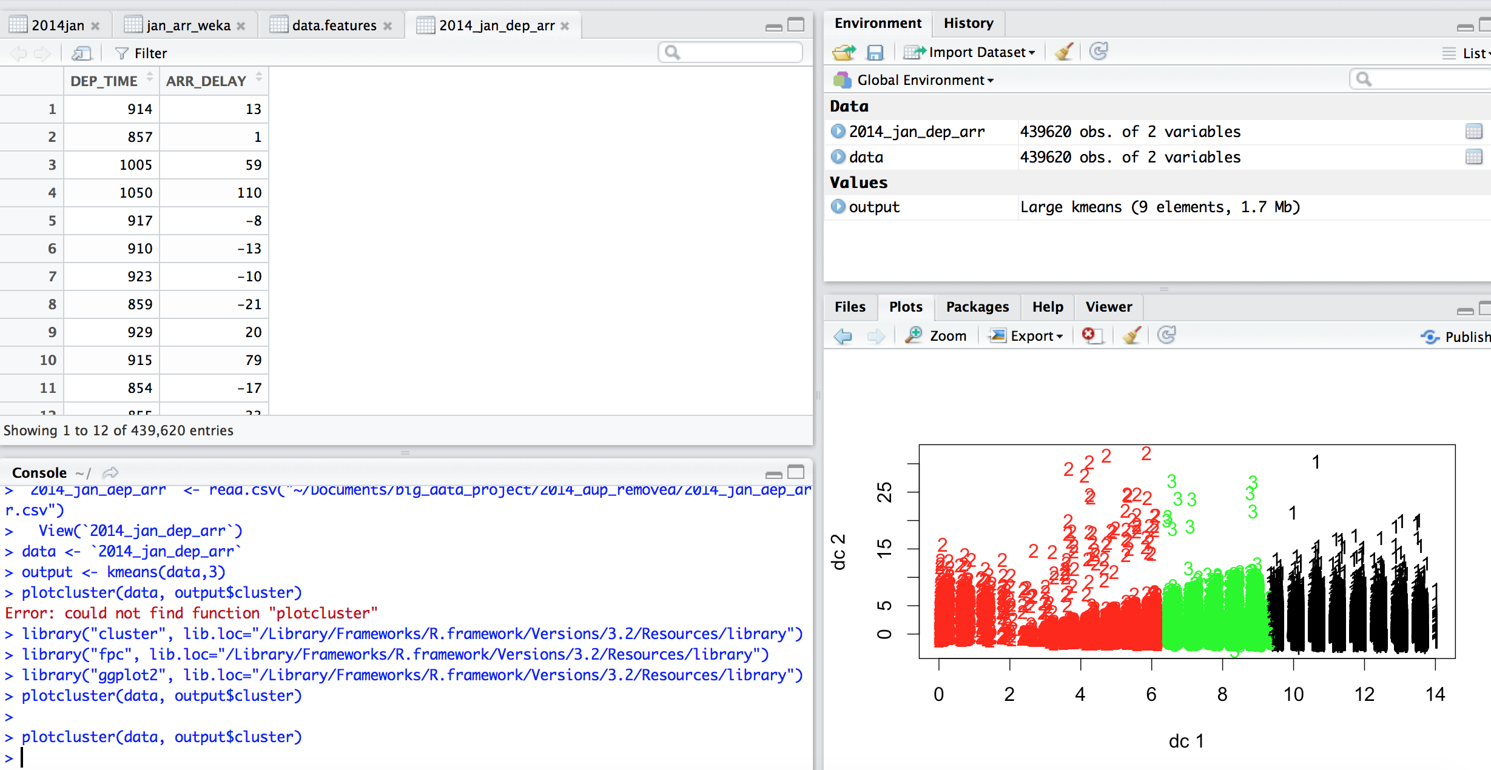
Comparing K-means output in Weka and R (2 attributes)
Output in Weka
http://stats.stackexchange.com/questions/31083/how-to-produce-a-pretty-plot-of-the-results-of-k-means-cluster-analysis
Output in R

Slide 22
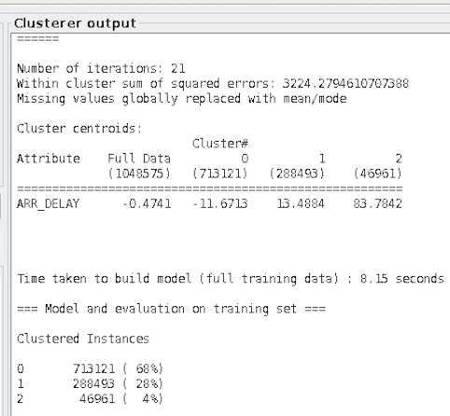
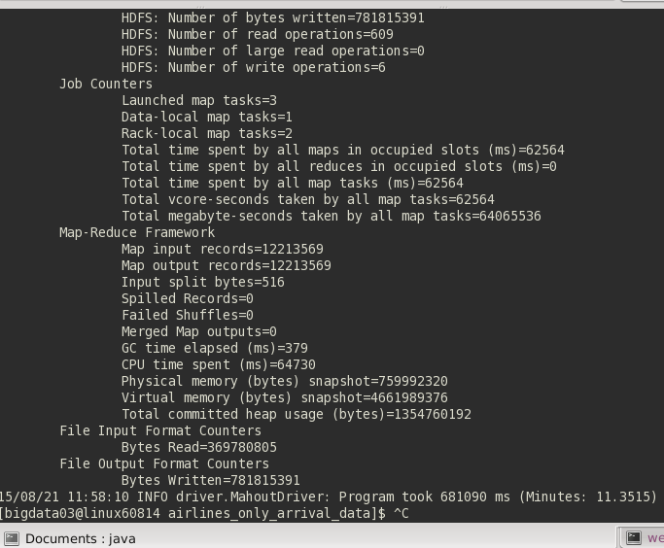
K-means on 1 attribute - Arrival delay (~20 MB)
Weka clustered properly with 3 clusters
Cluster centroids matches with the Mahout output.
Mahout took more time than Weka for 20 MB. Cluster centroids - c=[-11.671] r=[7.241]}, c=[13.488] r=[11.690]} c=[83.784] r=[29.032]}

Slide 23
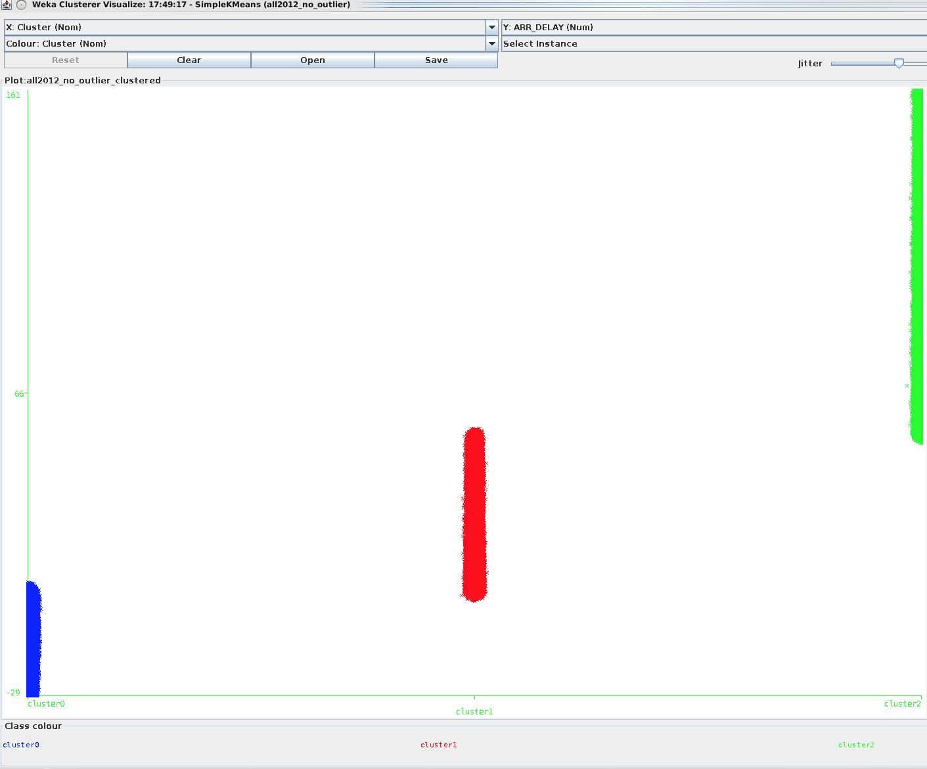
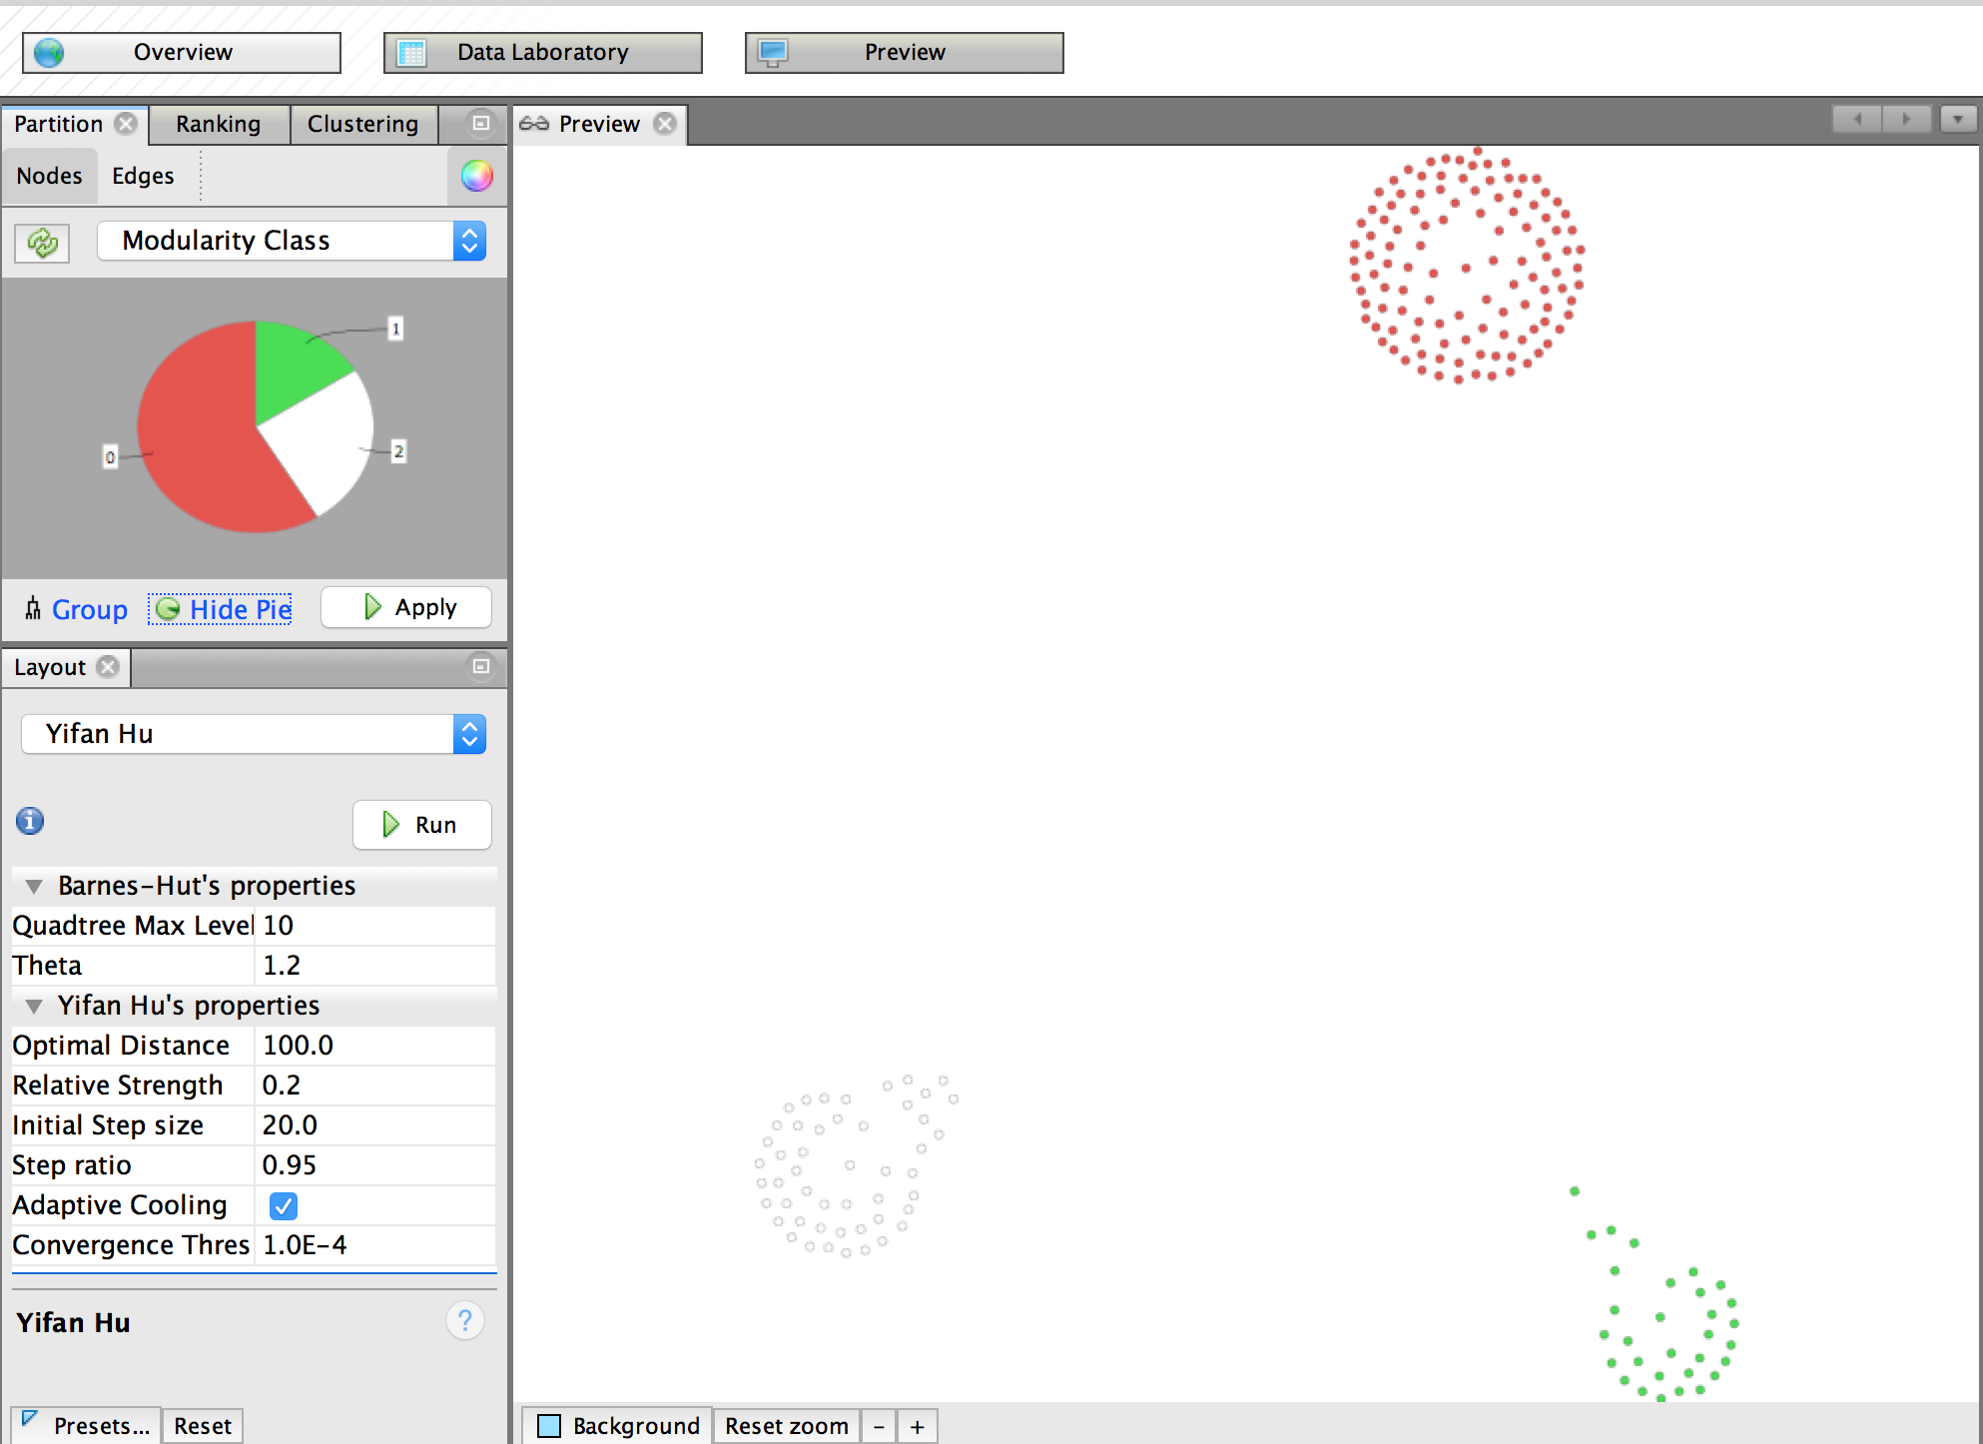
Visualization in Weka and Gephi (1 attribute)
Weka : X-axis -> Cluster Number
Y- axis -> Arrival Delay
Gephi Visualization

Slide 24
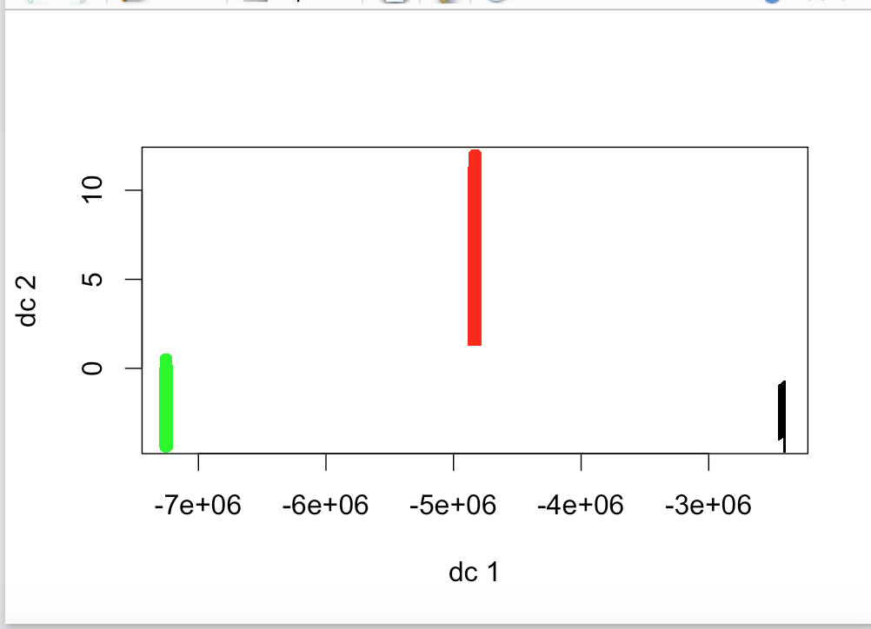
Visualization in R (1 attribute)
Quality of the cluster = between_SS / total_SS = 81.6 %
The above measure is an indication of how distinct are the different groups of clusters being formed.
http://stats.stackexchange.com/questions/48520/interpreting-result-of-k-means-clustering-in-r

Slide 25
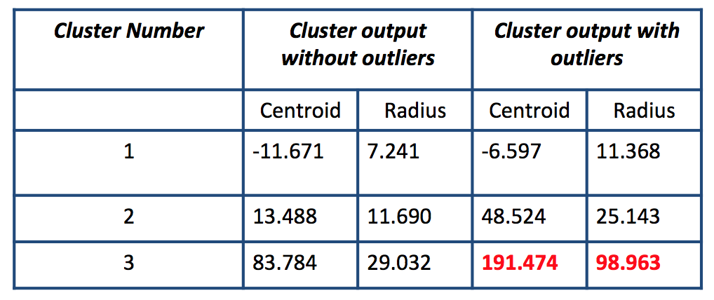
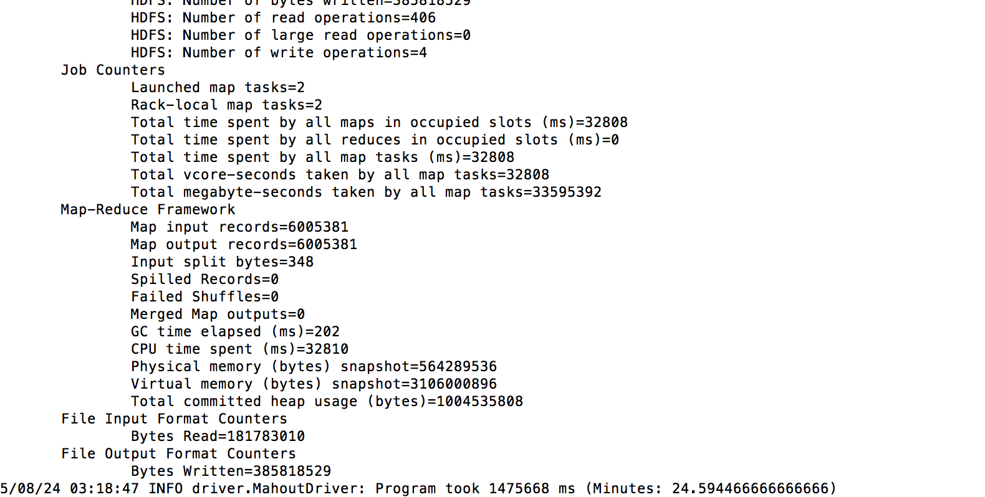
K-means with outliers and noisy data (1 attribute)
Mahout took more time than Weka for 20 MB. Cluster centroids - c=[48.524] r=[25.143]}, c=[191.474] r=[98.963]} c=[-6.597] r=[11.368]}
From the above table, it is evident that the quality of the clusters is greatly affected in the presence of outliers

Slide 26
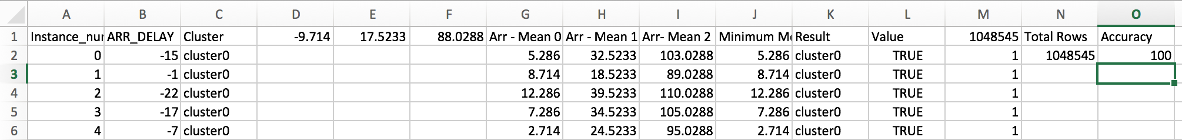
Accuracy
Input : Weka kmeans cluster output includes each data points and cluster number to which it belongs
Distance of each data point from 3 centroids (3 clusters) are calculated
Minimum distance is calculated and the associated cluster is noted
Check is made whether calculated cluster is same as the Weka output
Weka Output
Calculated Cluster Number

Slide 27
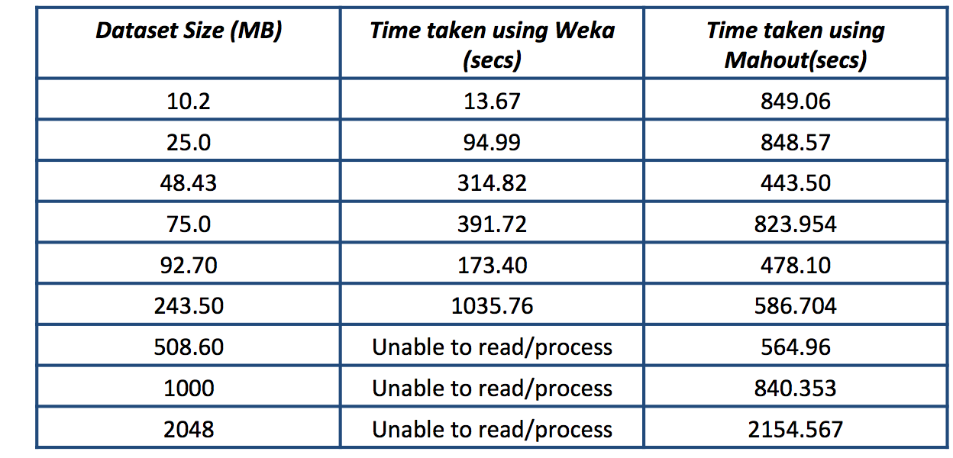
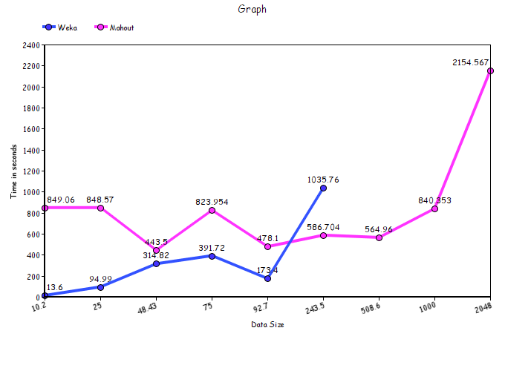
Performance between Weka Vs Mahout
in MB

Slide 28
Performance between Weka Vs Mahout - Observations
Weka could not handle datasets more than 50MB when the heap size was 1GB
Hence the heap size was increased to 6GB in Weka and Mahout to compare the performance
For 6GB heap size, Weka was able to handle datasets of size less than 320MB
Observation: Heap size was directly proportional to the processing capability of Weka
For smaller datasets, in the range 10MB to ~120MB, we found Weka had a better performance than Mahout
Observation: The initial setup of Mahout takes a longer time and hence gives a relatively poor performance compared to Weka. Thus, not suitable for small datasets
For medium to larger datasets, ~120MB to 2GB, Mahout ran much faster than Weka
Observation: The initial setup time taken by Mahout is negligible when compared to the time taken to process the data and hence suitable for processing large datasets

Slide 29
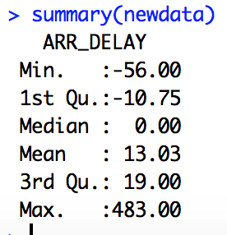
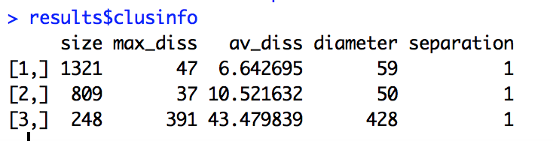
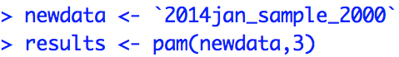
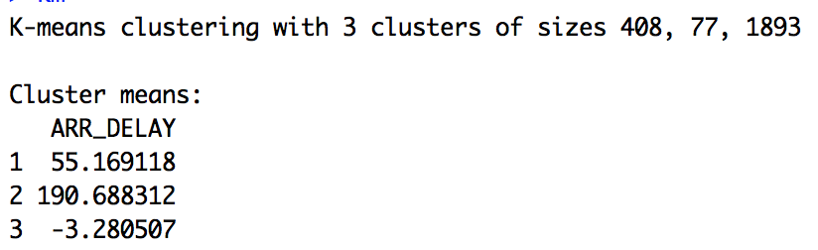
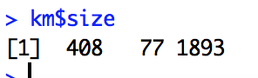
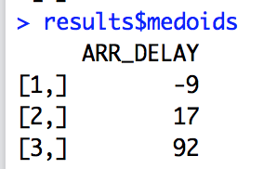
k medoids (PAM) Vs k means clustering in R
k medoids performs better when there are outliers.
Input data has outliers and there is a difference between medoids and centroids.
Data set was small (10K rows) because of memory issue in R with PAM.
K means cluster sizes
are different from
k medoids.
Mean 190 is because of outlier

Slide 30
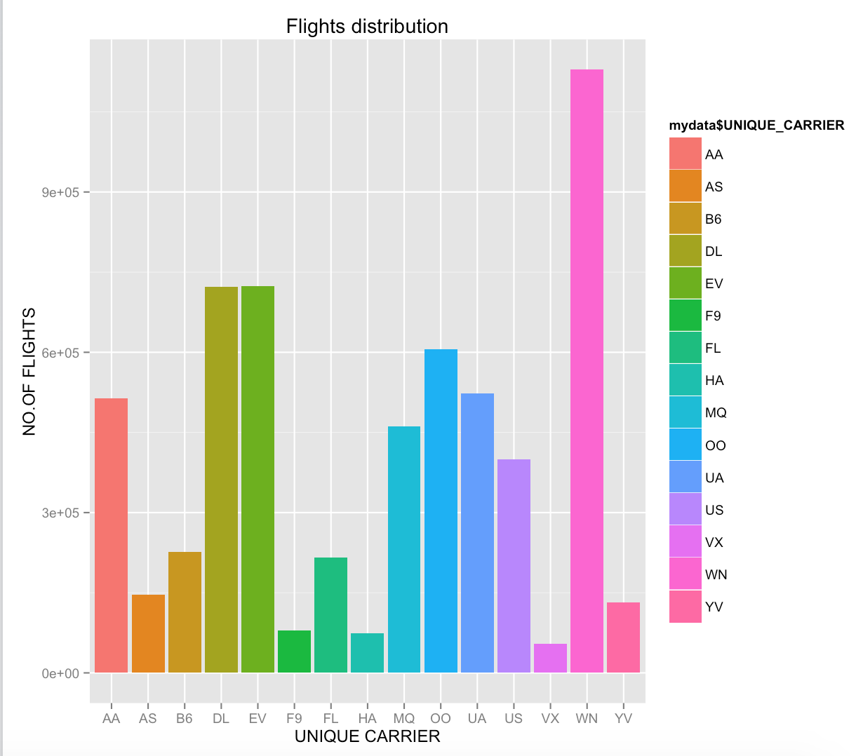
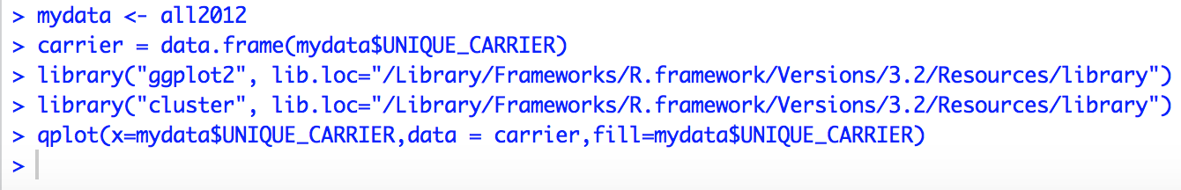
Observations in R
Southwest Airline runs most of the airplane in the U.S. in 2012.
The number of their flights are even greater than the sum of Skywest Airline and American Airline

Slide 31
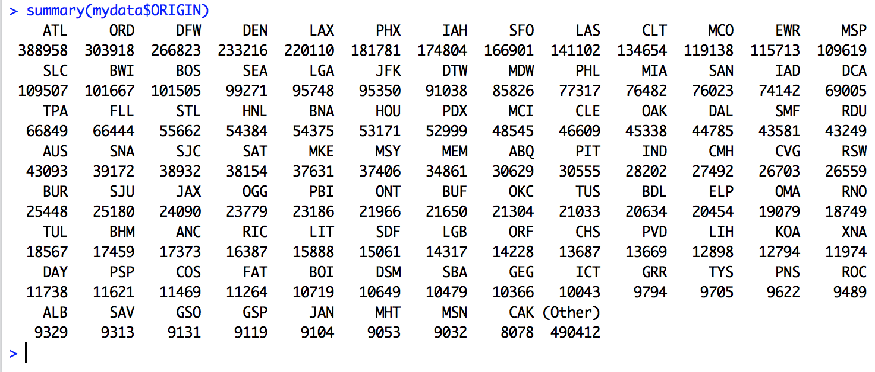
Observations in R contd.
The most busiest airport in the U.S. is Atlantic airport (ATL)
Chicago(ORD) and Dallas(DFW) ranked second and third

Slide 32
Challenges faced
Understanding the data
The US airlines is a huge collection of information with >100 attributes
Choosing the right attributes for analysis
Data preprocessing
Lot of time was spent in data preprocessing rather than the actual execution of the algorithm
Data conversion
Platform challenges
Weka, Apache Mahout, Hadoop MapReduce, Gephi and R were all new to the team and took a while to get accustomed
Data Visualization in gephi and resolving general issues was the greatest challenge

Slide 33
Lessons learnt
good insight on applying machine learning algorithm like KMeans on big data using Weka, Mahout, MapReduce and R
analysis is THE key factor when it comes to mining big data
various data pre-processing steps
technical skills: Weka, Mahout, Hadoop MapReduce, Spark, R and Gephi
always learnt something new when resolving issues
how to work as a team

Slide 34
Conclusion
Using k-means we could see that clustering on all features did not produce any useful information. Hence the best feature was selected for clustering
The optimum number of clusters for k-means clustering was calculated from “Elbow Technique”
Data preprocessing plays a major role when mining big data
The performance comparison showed that Weka performed better than Mahout for smaller datasets. For large datasets, Mahout runs faster than Weka
Data analysis and visualization was done using Weka,Mahout,R and Gephi
Outlier analysis showed how the presence of outliers affects the quality of the clusters ; how PAM is better than Kmeans in the presence of outliers
Thus, Kmeans can be used as a preprocessing step for other mining algorithms; dataset can be broadly grouped as flights with Minimum delay, Medium delay and High delay using the three clusters found.

Slide 35
References
http://www.edureka.co/blog/clustering-on-bank-data-using-r/
http://www.unc.edu/~rls/s151-09/class4.pdf
http://stats.stackexchange.com/questions/31083/how-to-produce-a-pretty-plot-of-the-results-of-k-means-cluster-analysis
http://mahout-hadoop.blogspot.com/2013/10/using-mahout-to-cluster-iris-data.html
https://mahout.apache.org/users/clustering/k-means-commandline.html
Convert csv to SequenceFile http://stackoverflow.com/questions/13663567/mahout-csv-to-vector-and-running-the-program https://github.com/josephmisiti/hadoop-examples/blob/master/mahout/clustering/CSVToMahout.java
http://www.statmethods.net/advgraphs/ggplot2.html
Gephi - http://sumnous.github.io/blog/2014/07/24/gephi-on-mac/
Gephi - https://lbartkowski.wordpress.com/2014/11/28/gephi-0-8-2-on-apple-osx-yosemite/
Gephi - http://blog.ouseful.info/2010/05/12/getting-started-with-the-gephi-network-visualisation-app-%E2%80%93-my-facebook-network-part-iv/
https://www.youtube.com/watch?v=WrjpO7CmUoQ&index=10&list=PLJbE6j2EG1pZnBhOg3_Rb63WLCprtyJag
https://stat.ethz.ch/R-manual/R-devel/library/cluster/html/pam.html

Slide 36
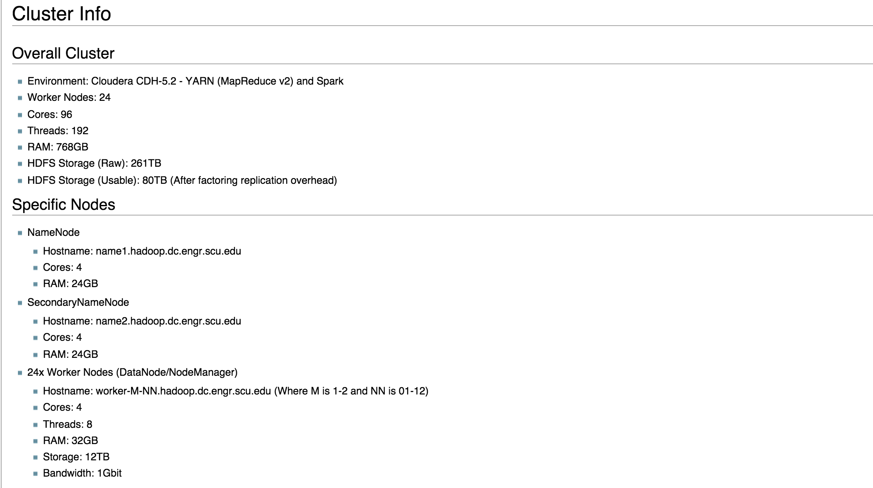
Cluster info
http://wiki.helpme.engr.scu.edu/index.php/Hadoop#Overall_Cluster

Slide 37
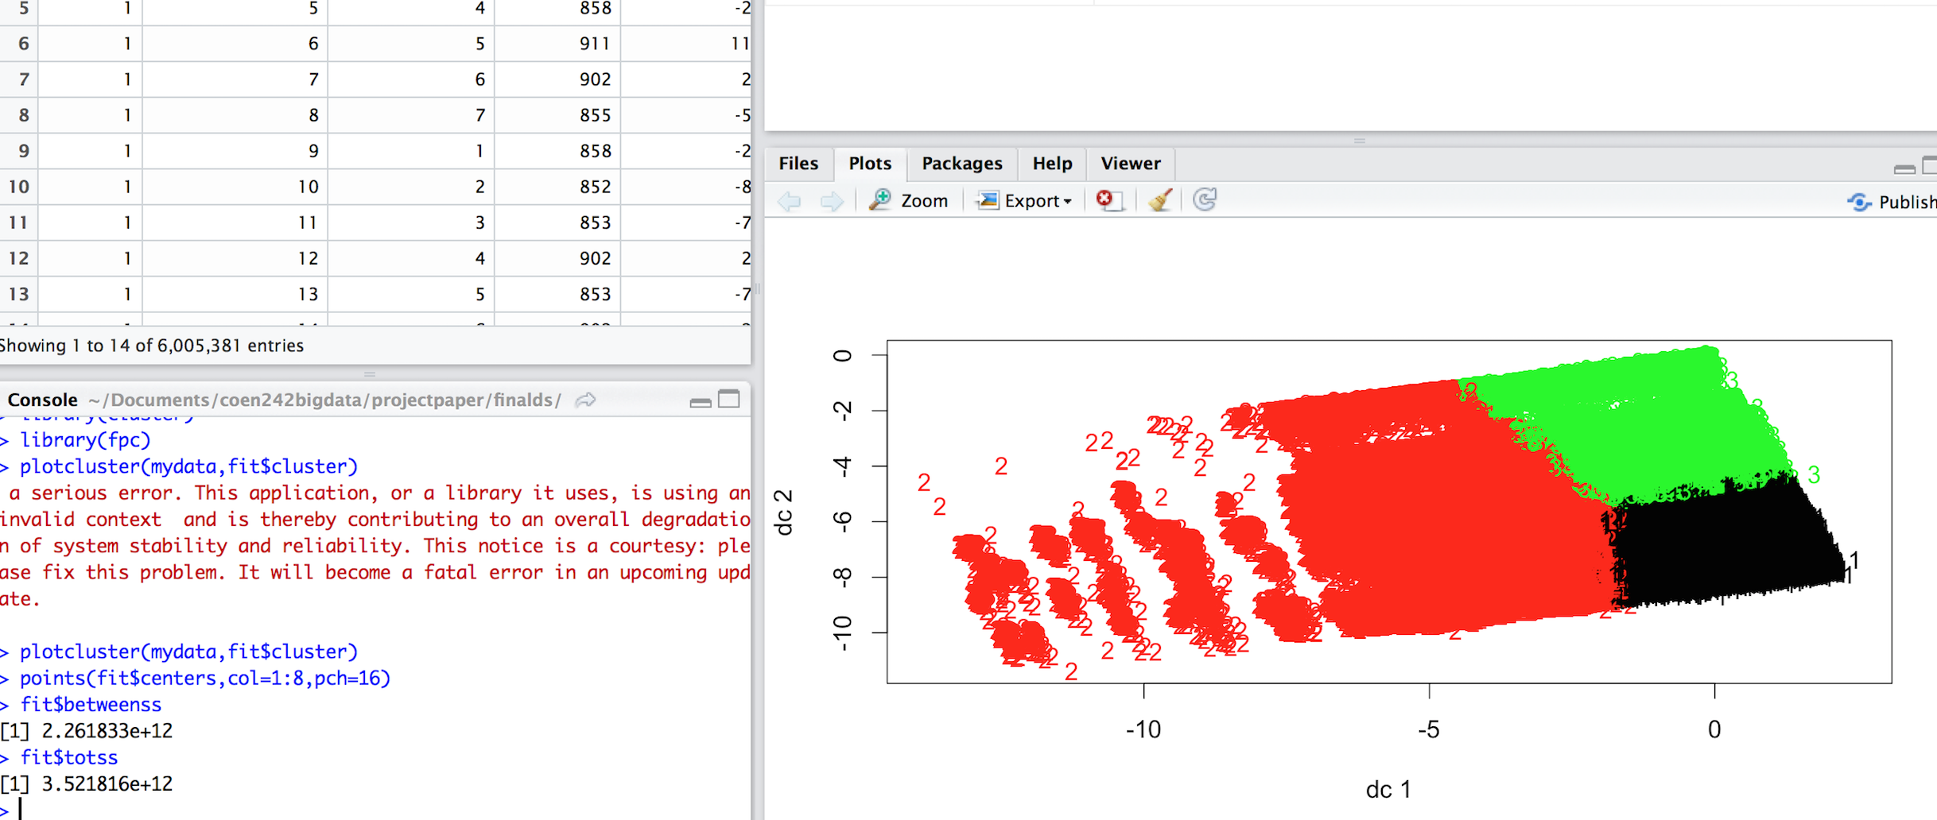
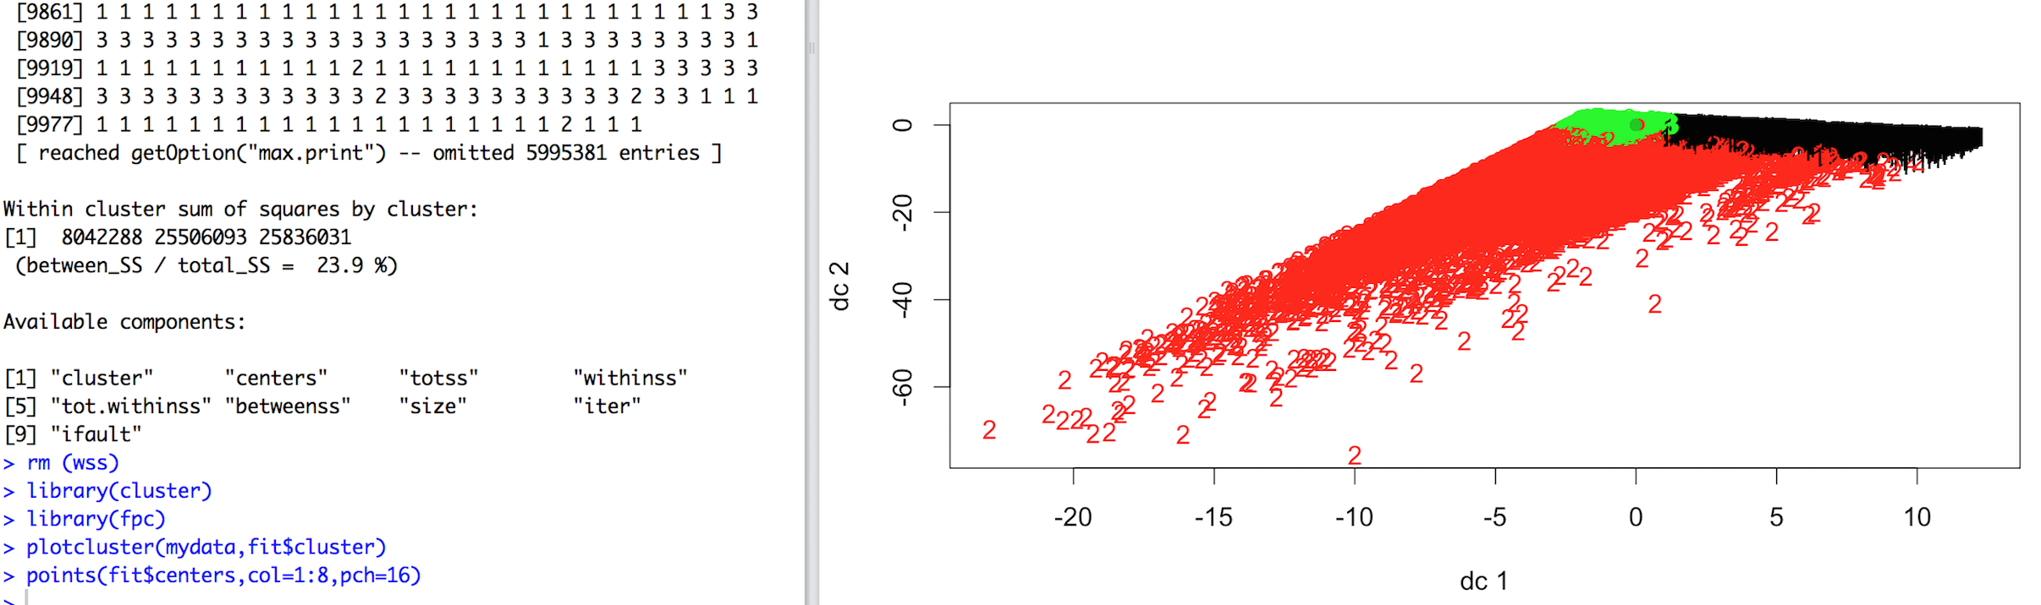
Normalized Vs Not normalized
Not normalized - 17 attributes
Normalized - 17 attributes

Slide 38
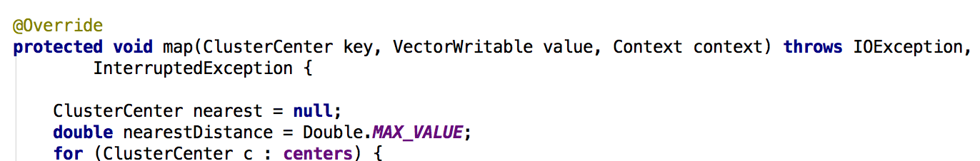
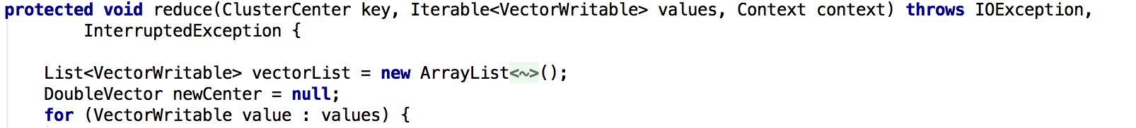
Implementation in Hadoop
Implemented the Kmeans algorithm using Hadoop MapReduce
Mapper code snippet Reducer code snippet

Slide 39
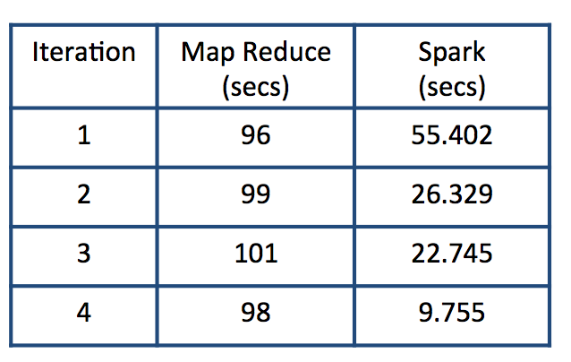
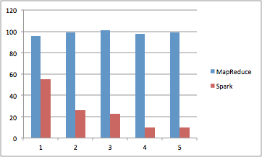
Word Count Implementation in MapReduce and Spark (Comparison - Datasize ~670MB)
The data shows that only the initial iteration of Spark took sometime but successive iterations dropped from 55secs to ~24secs. Once the “count” object was cached, it dropped even further to 9 secs. MapReduce had the same time in all iterations. Spark shows 10x more improvement than MapReduce!

Slide 40



MapReduce commands/output
WordCount - Java implementation
MapReduce output
Command: bigdata03@linux60815 wordcount]$ hadoop jar mapreduce-1.0-SNAPSHOT.jar learning.hadoop.wordcount.WordCountDriver /user/bigdata03/mrdata/files/*.txt wc-result-mr

Slide 41



Spark commands / output
Starting Spark
spark-shell --master yarn-client --num-executors 10
WordCount - code
val inputFile = sc.textFile("/user/bigdata03/sparkdata/files")
val words = inputFile.flatMap(a => a.split(" "))
val kv = words.map(a=> (a,1))
val count = kv.reduceByKey((a,b)=> a+b)
RDD created
count.toDebugString
Save Output to a File
count.saveAsTextFile("wc-result-spark")

